Slide 1
Meeting 19-11-2021

Slide 2
Deep learning for predicting ship motion from images
Predict pitch and roll 30 seconds ahead
CNN for image processing
LSTM network for time series processing
Autoencoder: pre-trained component in the models

Slide 3
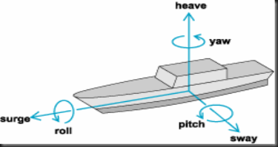
Parameters
Rotational
Yaw (human)
Pitch & Roll (wave)
Translational
Heave, sway & surge
Video/images
Camera:
Height, x-y-z rotations
Find optimum fps

Slide 4
Data preprocessing
Pixel data normalized to [-1,1]
Pitch and Roll normalized with absolute values [-90°,90°] to [-1,1]

Slide 5
Models
CNN, LSTM networks, Autoencoders (performance)
Images for input stacked or not
FC - Fully connected layers
PR - Pitch and Roll used as input
Encoder – LSTM architecture used to encode input vector
img-encoder – individual encoder to encode sequence of images
PR-encoder – individual encoder to encode sequence of pitch & roll
Decoder – LSTM architecture used to decode latent vector
MSE – pitch and roll at 10th predicted second

Slide 6
CNN models
CNN stack FC model
Predict sequence of seconds: higher MSE but justified
CNN stack PR FC model
Pitch and roll now considered, increased accuracy
CNN PR FC model
Seperate images as input: accuracy increase
Poor convergence
10th second MSE of p:28° and r:28°
10th second MSE of p:21° and r:22°
10th second MSE of p:11° and r:11°

Slide 7
LSTM CNN hybrid models
LSTM encoder decoder PR model
Sequence of past to sequence of future frames
10th second MSE of p:30° and r:29°
CNN LSTM img-encoder PR-encoder decoder
CNN extracts features, combined in vector for img-encoder
Pitch and Roll separately encoded
One latent vector is decoded
10th second MSE of p:3.5° and r:2.8°

Slide 8
LSTM CNN hybrid models
CNN LSTM encoder decoder images PR
Combine img-encoder and pr-encoder for less complexity
CNN LSTM encoder decoder images
Pitch and roll dropped
CNN LSTM images PR
Combine all LSTM elements into one
Reduce parameters, higher efficiency
10th second MSE of p:2.9° and r:2.7°
10th second MSE of p:3.4° and r:2.3°
10th second MSE of p:4.2° and r:4.1°

Slide 9
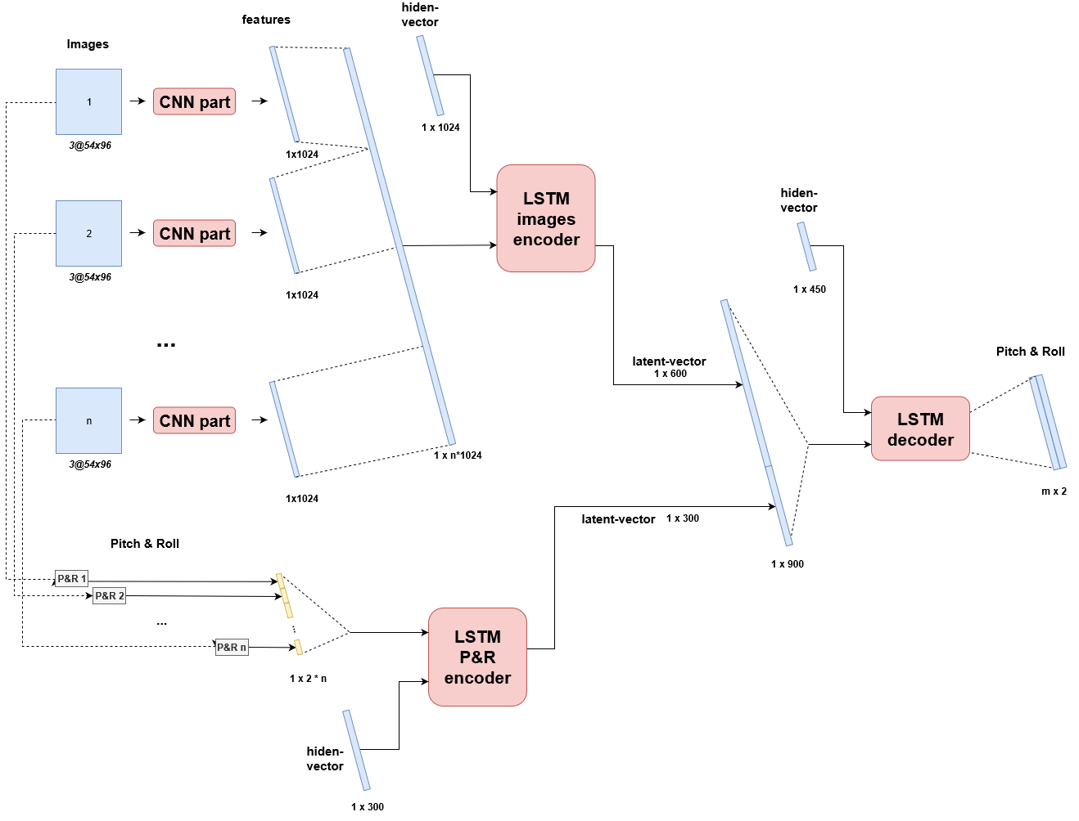

Slide 10
Optimizations
ADAM: adaptive learning rate optimization
MSE loss fuction
Early stopping rules to prevent overfitting
Hyperband algorithm for hyperparameter tuning

Slide 11
Future improvements
Test new sequence to sequence models
GRU-CNN model: faster then LSTM (Gated Recurrent Unit)
Test other hyperparameters (try keeping them as fixed as possible)
Using real images/video: how do the results change
Using more ship parameters/weather data (mainly wind & current) (available in blender)
Clever data augmentation: extend trainingset (mirror images, add fog, rain)

Slide 12
Next presentaion
The data split
Train/Test/Evaluation split
Test set is used for overfitting
Evaluation set is used for MSE
Criteria to benchmark the models and compare them
MSE relative to maximum values for pitch and roll
2.9° MSE is very high when the max value is only 10° roll
What are the maxima
Plot the results
Architectures for the models

Slide 13
Sources
Deep Learning For Predicting Ship Motion From Images – Nazar-Mykola Kaminskyi - https://github.com/Nazotron1923/Deep_learning_models_for_ship_motion_prediction_from_images/
Real-Time Ship Motion Forecasting Using Deep Learning – 2021 – Mohammad Hasanur Rashid, Jing Zhang, Minghao Zhao - https://dl.acm.org/doi/abs/10.1145/3448734.3450923
A Neural Conversational Model – 2015 - Oriol Vinyals, Quoc Le - https://arxiv.org/abs/1506.05869
A Co-operative Hybrid Model For Ship Motion Prediction - R. Skulstad, G. Li, T. I. Fossen, T. Wang, H. Zhang - https://www.researchgate.net/publication/351397594_A_Co-operative_Hybrid_Model_For_Ship_Motion_Prediction

